Slide 1
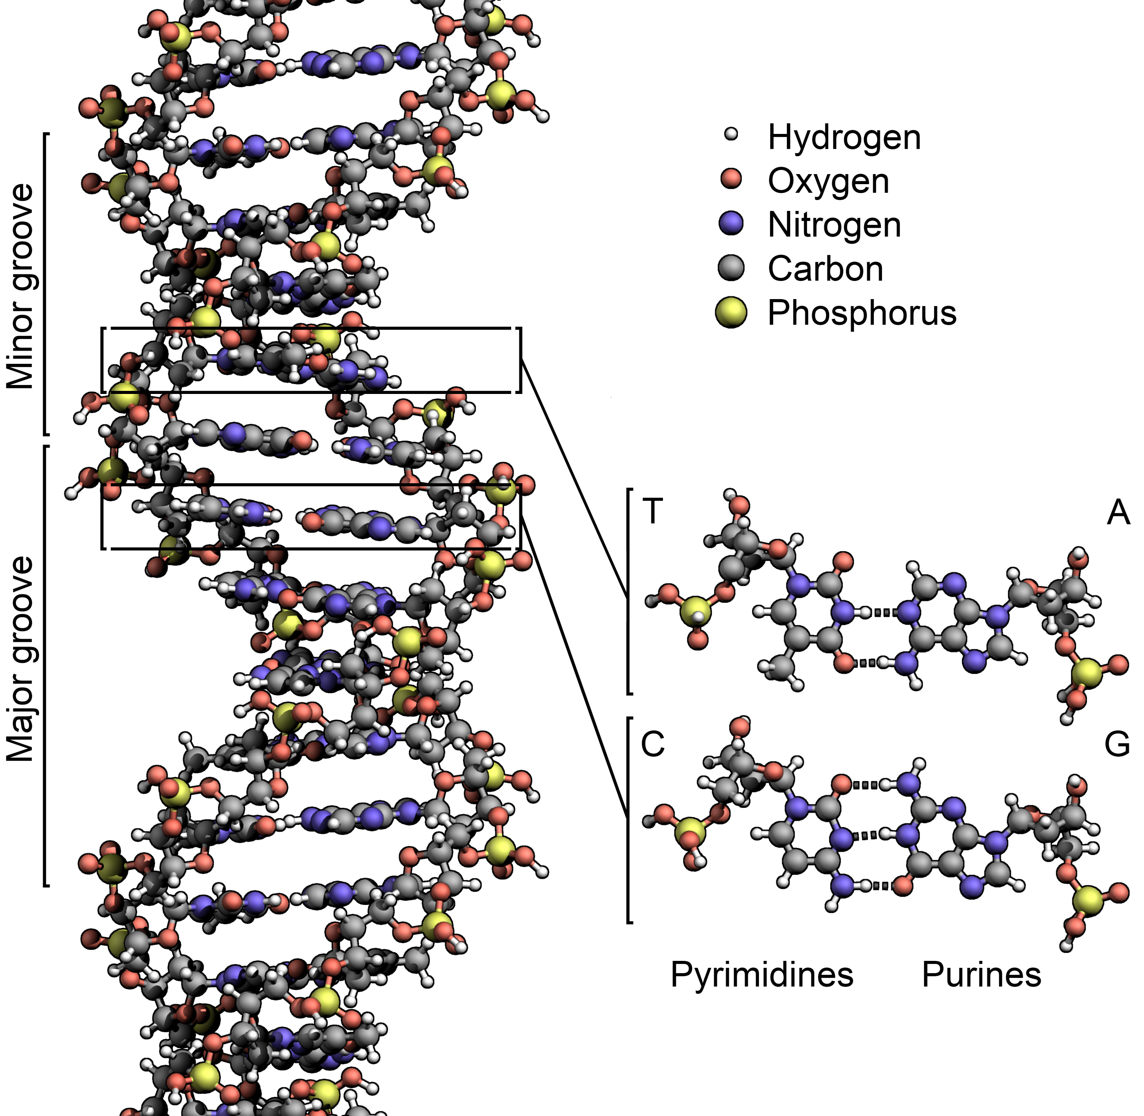
The Central Dogma of Molecular Biology
Ben Lacar, Ph.D.
Bioinformatics Scientist, Fluidigm Corporation
DeAnza College
March 21, 2019

Slide 2
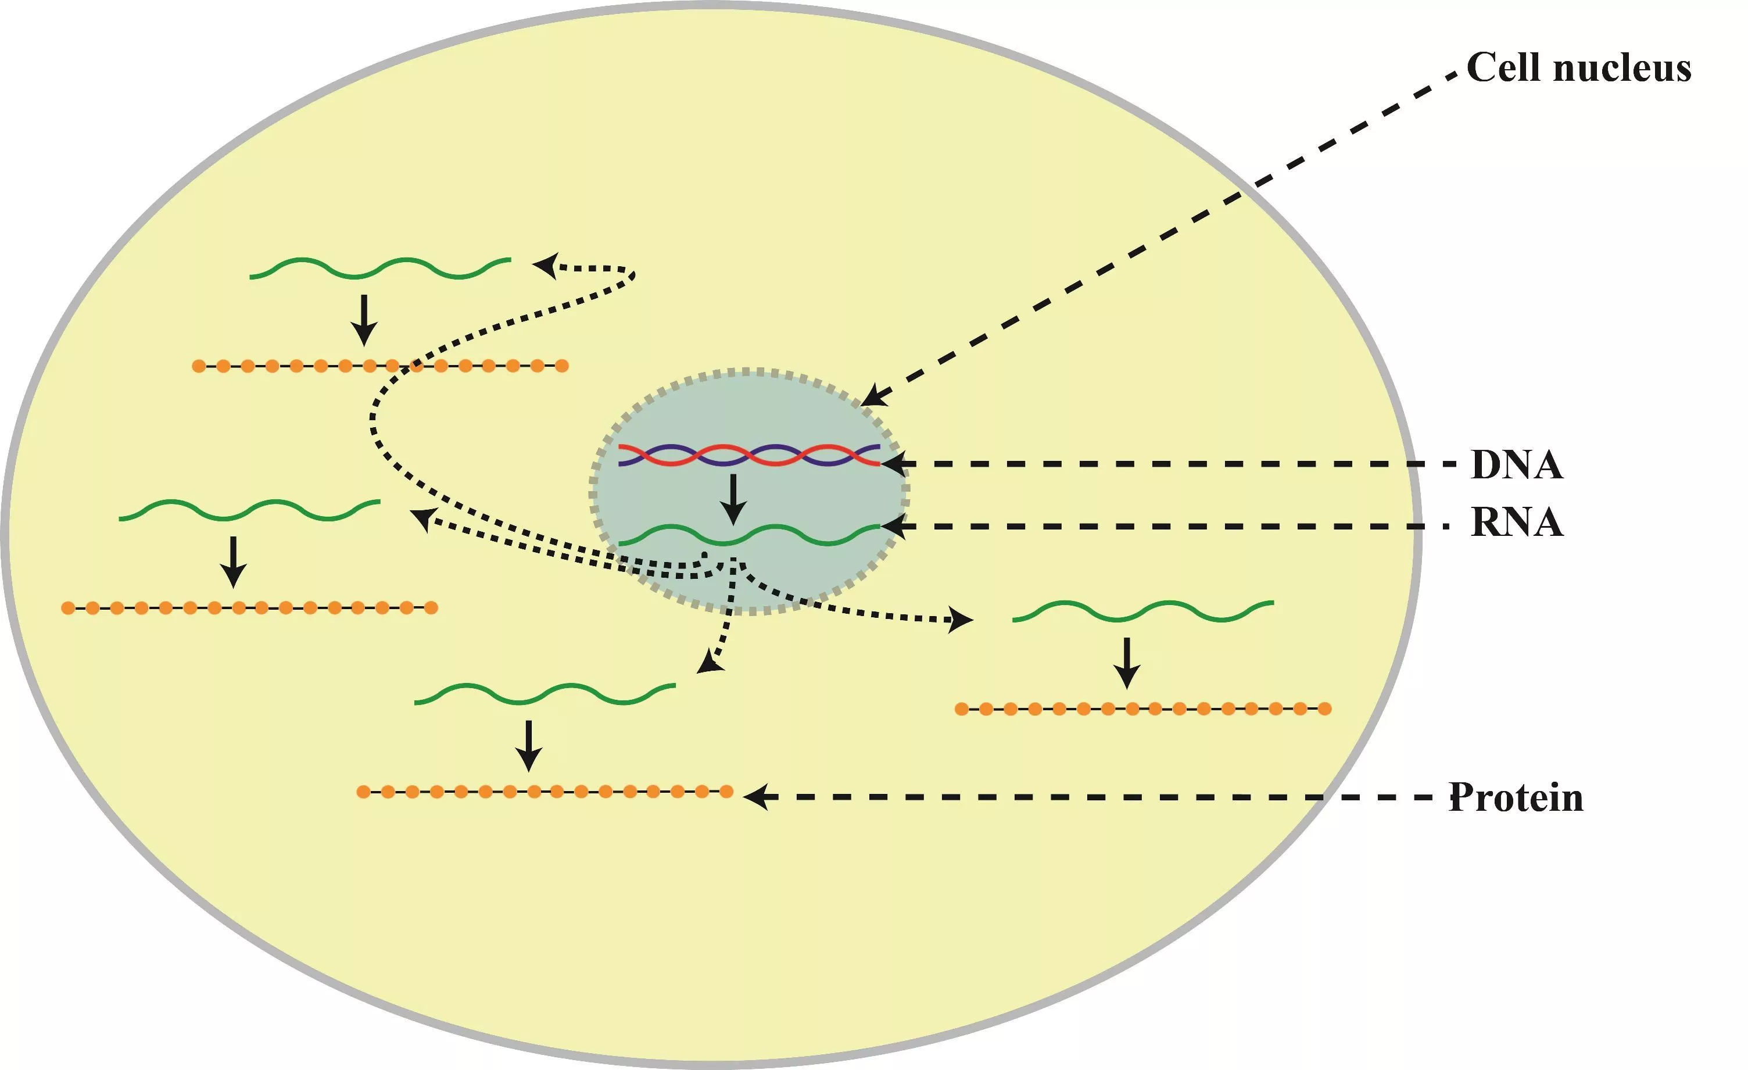
The most common interpretation of the Central Dogma of Molecular Biology
DNA makes RNA makes protein
https://science-explained.com/theory/dna-rna-and-protein/
Notes:
One way information flow….
DNA you may have heard about in crime scenes
RNA?
Protein here is not about muscle mass

Slide 3
A (re)-introduction to DNA, RNA, and protein

Slide 4
What is DNA? DNA is a code
Computer code uses 0 and 1
01100001
translates to
“a”
DNA code uses A, C, G, T
AGT
translates to
?
Notes:
Computer code machine language….

Slide 5
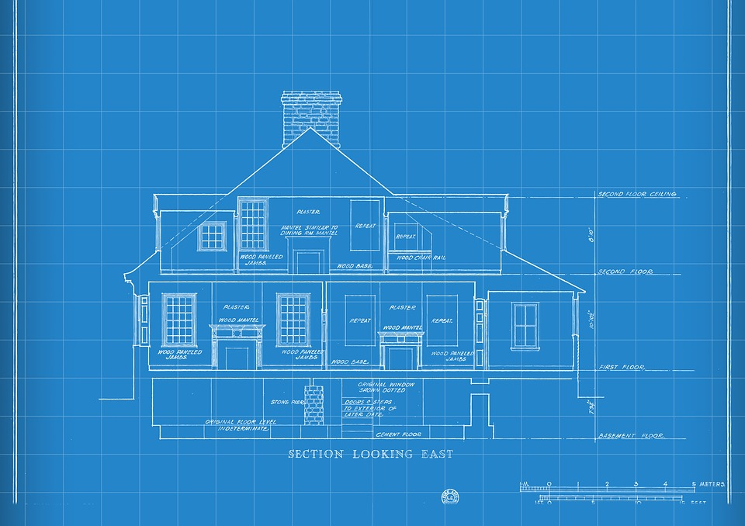
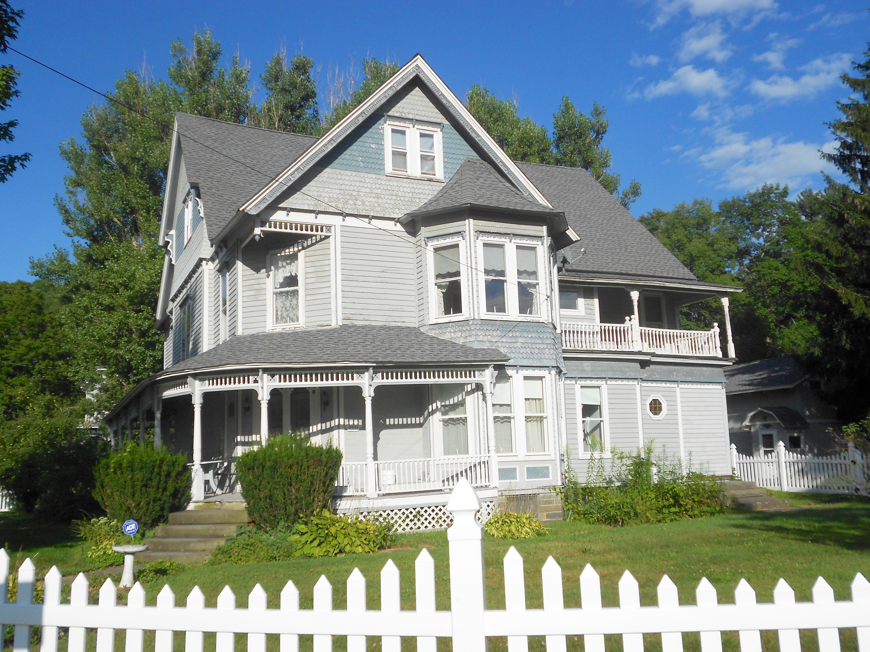
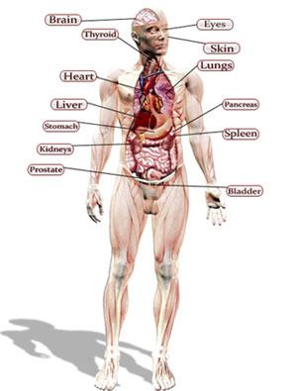
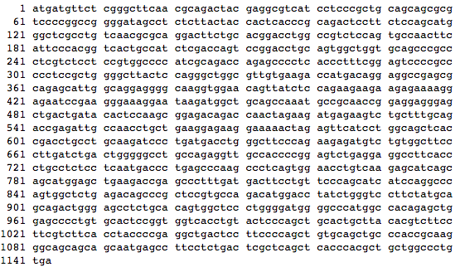
What is DNA? DNA is a “blueprint”
Notes:
Are blueprints functional?

Slide 6
A sequence of DNA is a chain of individual blocks called bases (nucleotides)
aaatataaactcacggaaccgtaagccgcgtaacctgtcaattcacggagaatagatgac
tgtttatccttgagccactttggaaccgtacgtggggggttggatggtgcgcatacctcg
cgaaggccaatacgcatatcgactggctcccagtttaggtccggttcatttgtgtttgtt
ggaaaataagtgatggcgccttaccgggagtaggagcaaaacaacctagctatttcttac
gaacggtttccatcttgagacgcataccattgtgaaagctatacctactgttgctacttg
gaggcagtctctgccgccatagtgccggcttggatactgttgtatagattgcgagacgta
gtcaccatatcgaccaaggttaagcaataccgttttgtgatccgcgctagcacgtccccg
ccagaacttctaaaggtccctgtaatgcgttatcctctataggtatggctatcgaaaaag
cgctacaaaccgcagccaagatttaatctcgaacctgaacccgcccatcgctccacagta
gtctaaaaaggacctttacgagagacatcgtacgaaaaggtctggcagctgttcggagct
cgcccactagcttgctaagtgaatacgctctacatggatgcacccttctaactgtttcag
tgattacgtgcgcaacatagagcgtaacgaacgcgtaactcttggataaatgggtaccgt
agtaggacgtttccaagccccatttgcccatatccactagggggtccaacgccgcttgtt
agggccggcccgacacacttgcggccgaccacggacatggtgcggaaccagaccaatgac
gggagattcctcgagcctcactcctttctaatcgtctcttactctggaactcgttccccg
cgtcagacctgcctaacaatacggaaaacctggtcgttccttaggcgcattgtaattacc
cgtacatcaagcaccaccggagatgaagaagccgtgttttaccgtgtctgtaaagaaacg
agccgcaagctatcattaatatgtcattagtagttgtggaatggcgctaggaatcagaca
ctgccctgtaaatgattcgcgccatcgaatgatataggactgaagcgagcctgggctata
ggctacaattaggacgtttccttctgctacaacctctttcggagtaatgcaacctcactt
actcactggtcatcacccagttgcagtacagggtcagtgatatttgtgatagggtacgtc
aaaatagcagtgagggtctagagcgtcatggaggggttaggccagacgtcggtgtcaggt
caggcggggagataagcgtccttatttcacgattaggcccgcaggagcgtcttaactaac
caacaacttggcggtagggggggtccttaaatgaggcattgatggatgatctatgtgagg
Notes:
3 billion human bases
Bases as in acid-base

Slide 7
Cellular functions are encoded by genes in our DNA
aaatataaactcacggaaccgtaagccgcgtaacctgtcaattcacggagaatagatgac
tgtttatccttgagccactttggaaccgtacgtggggggttggatggtgcgcatacctcg
cgaaggccaatacgcatatcgactggctcccagtttaggtccggttcatttgtgtttgtt
ggaaaataagtgatggcgccttaccgggagtaggagcaaaacaacctagctatttcttac
gaacggtttccatcttgagacgcataccattgtgaaagctatacctactgttgctacttg
gaggcagtctctgccgccatagtgccggcttggatactgttgtatagattgcgagacgta
gtcaccatatcgaccaaggttaagcaataccgttttgtgatccgcgctagcacgtccccg
ccagaacttctaaaggtccctgtaatgcgttatcctctataggtatggctatcgaaaaag
cgctacaaaccgcagccaagatttaatctcgaacctgaacccgcccatcgctccacagta
gtctaaaaaggacctttacgagagacatcgtacgaaaaggtctggcagctgttcggagct
cgcccactagcttgctaagtgaatacgctctacatggatgcacccttctaactgtttcag
tgattacgtgcgcaacatagagcgtaacgaacgcgtaactcttggataaatgggtaccgt
agtaggacgtttccaagccccatttgcccatatccactagggggtccaacgccgcttgtt
agggccggcccgacacacttgcggccgaccacggacatggtgcggaaccagaccaatgac
gggagattcctcgagcctcactcctttctaatcgtctcttactctggaactcgttccccg
cgtcagacctgcctaacaatacggaaaacctggtcgttccttaggcgcattgtaattacc
cgtacatcaagcaccaccggagatgaagaagccgtgttttaccgtgtctgtaaagaaacg
agccgcaagctatcattaatatgtcattagtagttgtggaatggcgctaggaatcagaca
ctgccctgtaaatgattcgcgccatcgaatgatataggactgaagcgagcctgggctata
ggctacaattaggacgtttccttctgctacaacctctttcggagtaatgcaacctcactt
actcactggtcatcacccagttgcagtacagggtcagtgatatttgtgatagggtacgtc
aaaatagcagtgagggtctagagcgtcatggaggggttaggccagacgtcggtgtcaggt
caggcggggagataagcgtccttatttcacgattaggcccgcaggagcgtcttaactaac
caacaacttggcggtagggggggtccttaaatgaggcattgatggatgatctatgtgagg
Notes:
3 billion human bases

Slide 8
Why is DNA in the shape of a double helix? A double-stranded helix is very chemically stable
DNA: deoxyribonucleic acid
Wikipedia
Notes:
How stable? The outside like water. The insides are hydrophobic, like oil, so they will always face each other, unless enzyme’s open them up.
If DNA is transmitting the code of life, it has to be able to survive harsh temperatures, be somewhat chemically resistant to what’s in the environment.
DNA can be found in crime scenes through blood or bodily fluids.

Slide 9
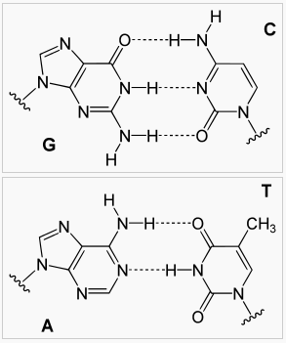
DNA nucleotides (bases) always pair the same way A pairs with T, G pairs with C
Cytosine
Guanine
Thymine
Adenine
Wikipedia
Notes:
Which of these pairs do you think are even more stable?

Slide 10
What is the sequence of the other strand?
ATGATGTTCTCGGGCTTCAA

Slide 11
The two strands of DNA are referred to as “sense” and “antisense”
ATGATGTTCTCGGGCTTCAA
TACTACAAGAGCCCGAAGTT
sense
antisense

Slide 13
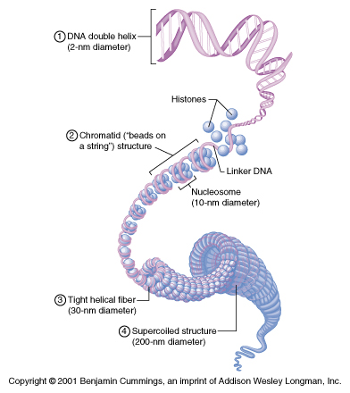
Supercoiled DNA allows it to reside in the cell nucleus

Slide 14
Base pairing provides a mechanism for copying Transcription: Copying a part of DNA (a gene) as RNA
DNA makes RNA makes protein
Notes:
I have two mistakes here, can anyone catch it?

Slide 15
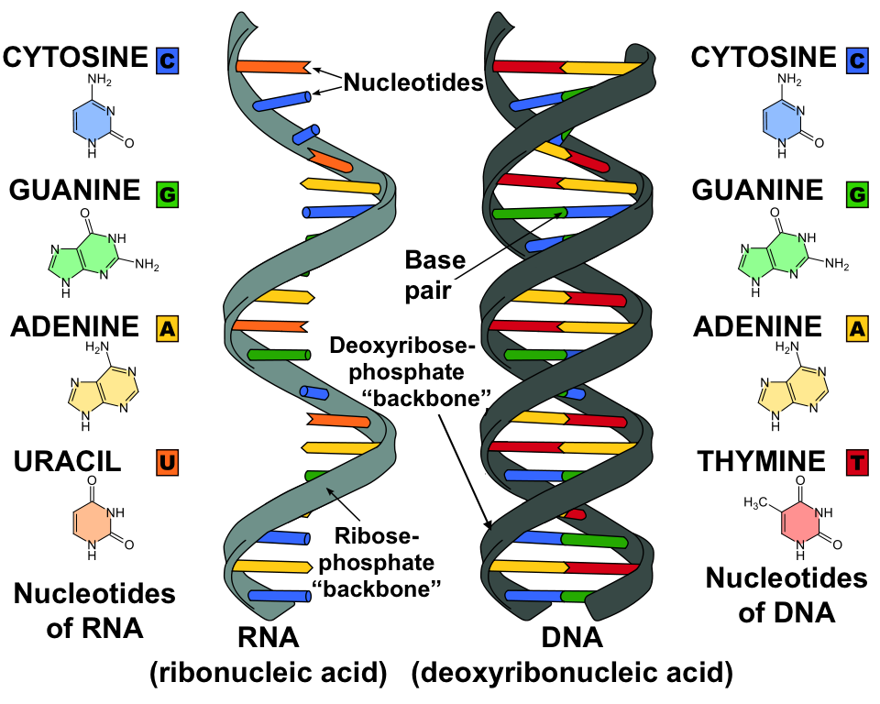
What is RNA? RNA is like DNA but single-stranded and uses U instead of T
Khan Academy

Slide 16
RNA is a transcription of DNA using the “antisense” strand as a template
TACTACAAGAGCCCGAAGTT
antisense
Notes:
Swap it with your neighbor… swap with a different neighbor

Slide 18
DNA supercoiling can impact expression of RNA (transcription)

Slide 19
What is RNA? messenger RNA (mRNA) is a transcription of a gene from DNA
DNA (with many genes)
aaatataaactcacggaaccgtaagccgcgtaacctgtcaattcacggagaatagatgac
tgtttatccttgagccactttggaaccgtacgtggggggttggatggtgcgcatacctcg
cgaaggccaatacgcatatcgactggctcccagtttaggtccggttcatttgtgtttgtt
ggaaaataagtgatggcgccttaccgggagtaggagcaaaacaacctagctatttcttac
gaacggtttccatcttgagacgcataccattgtgaaagctatacctactgttgctacttg
gaggcagtctctgccgccatagtgccggcttggatactgttgtatagattgcgagacgta
gtcaccatatcgaccaaggttaagcaataccgttttgtgatccgcgctagcacgtccccg
ccagaacttctaaaggtccctgtaatgcgttatcctctataggtatggctatcgaaaaag
cgctacaaaccgcagccaagatttaatctcgaacctgaacccgcccatcgctccacagta
gtctaaaaaggacctttacgagagacatcgtacgaaaaggtctggcagctgttcggagct
cgcccactagcttgctaagtgaatacgctctacatggatgcacccttctaactgtttcag
tgattacgtgcgcaacatagagcgtaacgaacgcgtaactcttggataaatgggtaccgt
agtaggacgtttccaagccccatttgcccatatccactagggggtccaacgccgcttgtt
agggccggcccgacacacttgcggccgaccacggacatggtgcggaaccagaccaatgac
gggagattcctcgagcctcactcctttctaatcgtctcttactctggaactcgttccccg
cgtcagacctgcctaacaatacggaaaacctggtcgttccttaggcgcattgtaattacc
cgtacatcaagcaccaccggagatgaagaagccgtgttttaccgtgtctgtaaagaaacg
agccgcaagctatcattaatatgtcattagtagttgtggaatggcgctaggaatcagaca
ctgccctgtaaatgattcgcgccatcgaatgatataggactgaagcgagcctgggctata
ggctacaattaggacgtttccttctgctacaacctctttcggagtaatgcaacctcactt
actcactggtcatcacccagttgcagtacagggtcagtgatatttgtgatagggtacgtc
aaaatagcagtgagggtctagagcgtcatggaggggttaggccagacgtcggtgtcaggt
caggcggggagataagcgtccttatttcacgattaggcccgcaggagcgtcttaactaac
caacaacttggcggtagggggggtccttaaatgaggcattgatggatgatctatgtgagg
uuaccgggaguaggagcaaaacaaccu
mRNA expression of one gene

Slide 20
RNA is literally and metaphorically central to the Central Dogma
It degrades relatively easily but this facilitates gene expression control
Messenger RNA (mRNA) has a coding role to produce protein, but other classes of RNA can be functional on its own (noncoding RNA)
DNA makes RNA makes protein

Slide 21
RNA provides the template to produce protein Translation: Going from nucleotides to amino acids
DNA makes RNA makes protein
Notes:
I have two mistakes here, can anyone catch it?

Slide 22
Transcription vs. translation
DNA makes RNA makes protein
Transcription:
script, scribe, scripture
nucleotide to nucleotide
Translation:
going from one language to another
nucleotide to amino acid

Slide 23
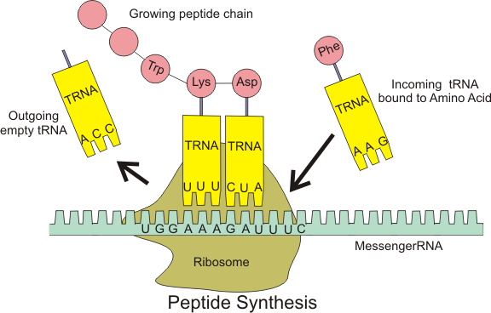
Transfer RNA (tRNA) serves as the molecular translator between mRNA and proteins
Wikipedia

Slide 24
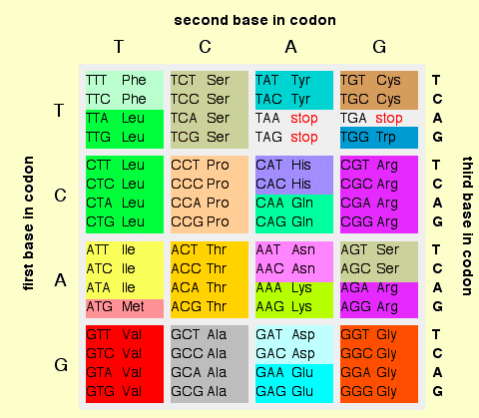
Three-base codons in DNA/RNA become translated to amino acids in protein
ATGATGTTCTCGGGCTTC
Notes:
https://www.integratedbreeding.net/courses/genomics-and-comparative-genomics/www.generationcp.org/genomics/index2ab1.html?page=1156
How many acids would there be if you translated a sequence of 30 bases?

Slide 26
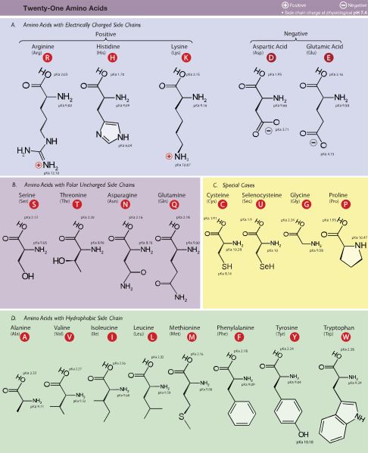
What are amino acids? Building blocks of protein that can be quite different from each other
Nucleotides
Amino acids
Only four with similar chemical properties
Leads to only helixes being formed
21 amino acids
A variety of protein shapes can be formed

Slide 27

Amino acids have a variety of chemical properties Giving rise to different secondary and tertiary structures
21 total amino acids.
20 are “standard” amino acids that are decoded by DNA/RNA.
9 are “essential” in that they only come from the diet. The body cannot produce them.

Slide 28
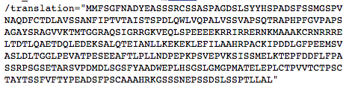
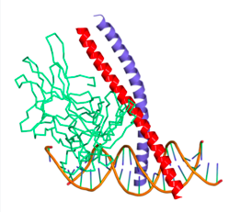
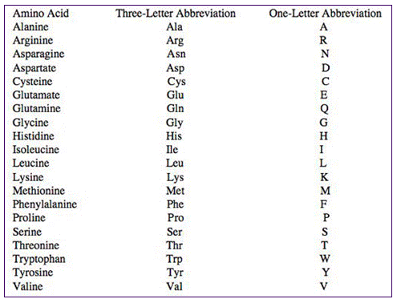
Structure can be described at different levels
Primary structure
(sequence of AAs)
Secondary structure
Tertiary structure
(overall shape of the protein)
Notes:
This is a transcription factor
Look at this protein structure

Slide 29
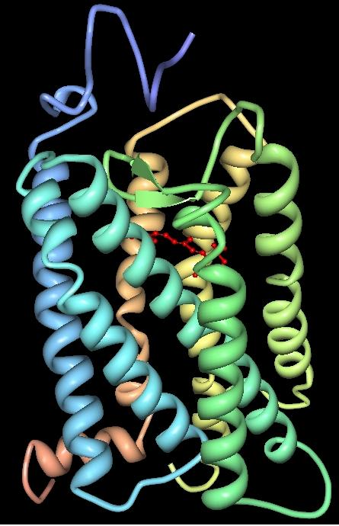
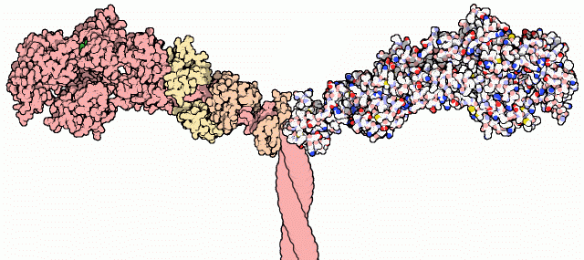
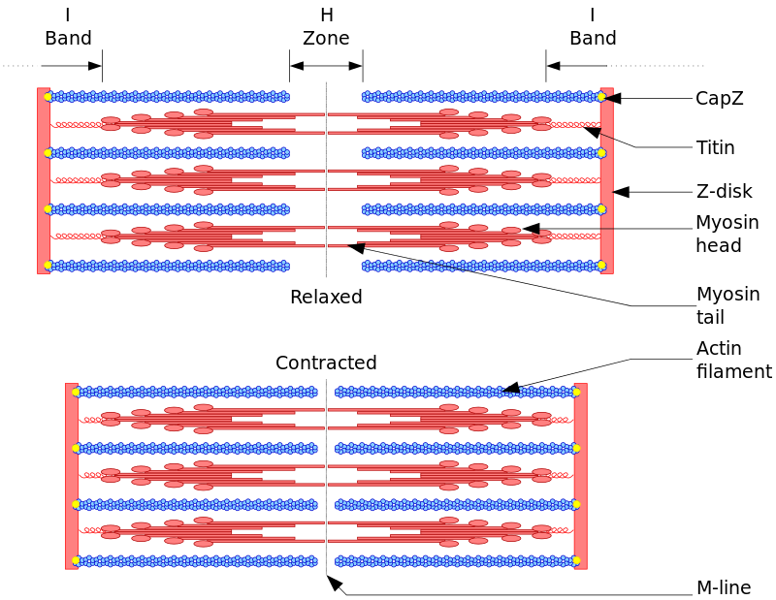
Variety of amino acid types means a variety of protein shapes and functions “Form follows function”
Rhodopsin
(found in the eye)
Myosin
(found in muscle)

Slide 30
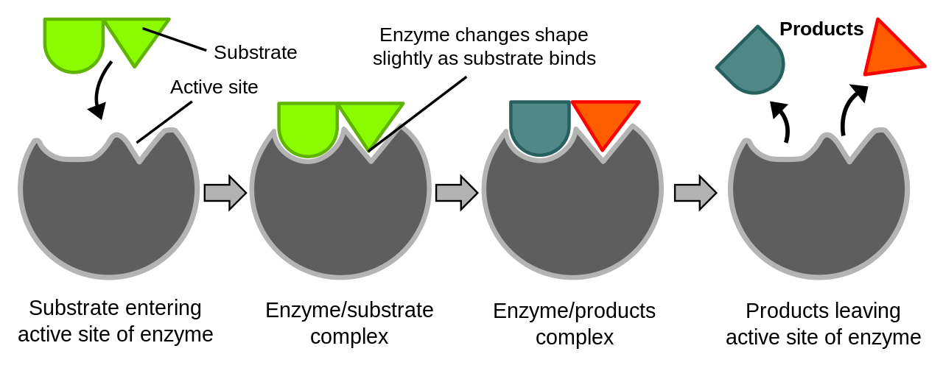
Enzymes, which are proteins, catalyze biochemical reactions
Enzymes are like a key and players in a chemical reaction are the locks
Drugs often interact with enzymes

Slide 31
How the Central Dogma influences our biology

Slide 32
Cellular location of DNA, RNA and protein
Notes:
DNA is protected from the rest of the cell
RNA is transient
Protein can go back to nucleus

Slide 33
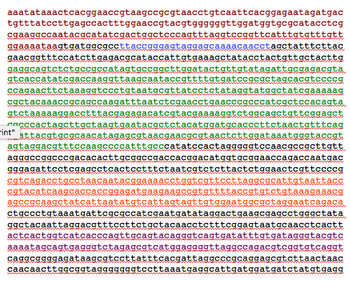
The same DNA is in every cell of our bodies but selective expression of RNA and protein leads to tissue specialization and function
“brain” mRNA/protein
“eye” mRNA/protein
“bladder” mRNA/protein
Notes:
Are blueprints functional?

Slide 34
The players in the Central Dogma of Molecular biology
 | Building block | Shape | Function | Location within a cell | Location within the body
DNA | Nucleotide | Double helix | Codes genetic blueprint. | Nucleus | Everywhere
RNA | Nucleotide | Helix | Transient genetic expression. | Cytoplasm (primarily) | Expression is mostly specific to tissue and timing.
Protein | Amino acid | Many types! | Majority of cellular functions. | Nucleus and cytoplasm | Expression is mostly specific to tissue and timing.
Notes:
Help fill in

Slide 35
Themes of the Central Dogma of Molecular Biology
DNA is stable allowing the blueprint to be preserved.
The amino acid code has redundancy so that errors are minimized.
Form follows function.

Slide 36
Variants in genetic code contribute to evolution and disease
DNA sequencing is widely used to understand sequences at the DNA or RNA level.
Single-nucleotide changes can cause cystic fibrosis
Exhibiting many repeats of “CAG” (encodes glutamine) is the basis for several neurological disorders
Companies like 23 and Me and Ancestry sequence DNA to help people understand heredity
Humans share over 99% of bases… the variations are in that very small percentage.
Notes:
That’s it, thank you good night.
One way information flow

Slide 37
The Central Dogma of Molecular Biology is a “Central Dogma”
DNA makes RNA makes protein
Some of the most interesting modern research involves differences from the most common interpretation!
Notes:
One way information flow….

Slide 38
Learning more and potential careers

Slide 39
Learning more and potential careers
Khan Academy
Internships in university labs or some biotechs
Longer-term careers available at all education levels

Slide 40
Review

Slide 41
What is the correct order of the Central Dogma of Molecular Biology?
RNA-DNA-protein
Protein-RNA-DNA
DNA-protein-RNA
DNA-RNA-protein

Slide 42
Which DNA base pair is more stable?
A-G
G-C
A-T
U-A

Slide 43
Which of these happens during transcription?
All of DNA is transcribed to RNA
A selective part of DNA (gene) is transcribed
All of RNA is transcribed to protein
A part of RNA is transcribed to protein

Slide 44
Which of these happens during translation? (pick two)
A selective part of DNA (gene) is transcribed
Messenger RNA is transcribed to protein
A part of RNA is transcribed to protein
The “language” of the code changes from bases to amino acids

Slide 45
All bases in RNA are the same as in DNA except which of the following?
A
C
G
T

Slide 46
What kind of RNA serves as the molecular translator during translation?
Transfer RNA
Messenger RNA
Noncoding RNA

Slide 47
Which of these is more stable?
RNA
DNA

Slide 48
If the DNA strand below is in the “sense” orientation, what is its “antisense” complement?
TGCAAGCTCGGATCT
TGCAAGCTCGGATCT
UGCAAGCUCGGAUCU
AGCATGCTTAATCGC
ACGTTCGAGCCTAGA

Slide 49
Why can protein provide more function to a cell than DNA or RNA?
Protein is more essential than DNA or RNA.
It is located in more cells.
It has a greater diversity of building blocks, leading to greater diversity of shapes, and therefore more functions.
It has a lower diversity of building blocks, leading to lower diversity of shapes, and therefore more functions.

Slide 50
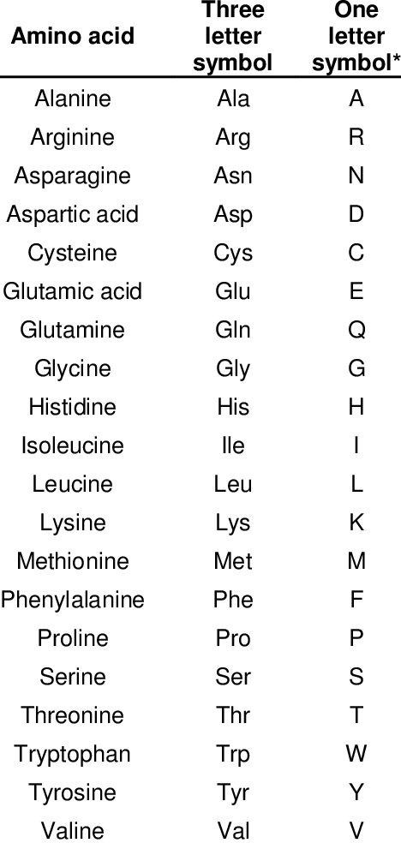

Slide 51
Appendix

Slide 52
Other topics
Diseases
Polyglutamine
DNA replication vs. transcription
Scientists behind the scenes

